Slide 1
Data Warehouse- test automation
Dariusz Szudrzyński
28.11.2016

Slide 2
AGENDA
Data Warehouse- introduction
Data Warehouse- types of tests
Practical part

Slide 3
Hurtownia danych- definicja
Data warehouse- introduction
DataWarehouse is central repository of integrated data from one or more disparate sources.

Slide 4
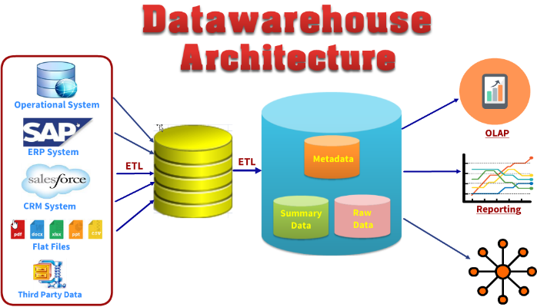
Data Warehouse example
Data warehouse- introduction

Slide 5
Multi-dimensional data model
Data warehouse- introduction
Fact table
In data warehousing, a Fact table consists of the measurements, metrics or facts of a business process. It is located at the center of a star schema or a snowflake schema surrounded by dimension tables. A fact table typically has two types of columns: those that contain facts and those that are a foreign key to dimension tables.
Dimension table
A dimension is a structure that categorizes facts and measures in order to enable users to answer business questions. Commonly used dimensions are people, products, place and time

Slide 6
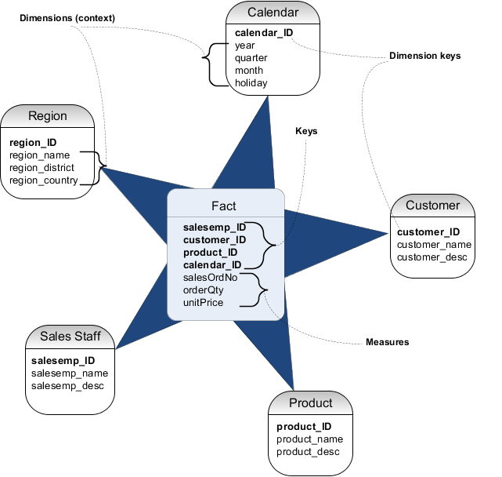
Star schema
Data warehouse- introduction

Slide 7
Data Warehouse- types of tests

Slide 8
Data operations
Data warehouse- testing
Extract
Transform
Load
Filter
Aggregate
Join

Slide 9
What we need for effective testing?
Data warehouse- testing
Test data
Test framework
Code repository
Contionus integration
Bug report

Slide 10
What and how we should test?
Data warehouse- testing
Data flow
Data sets
Data quality
Performance

Slide 11
Practical part

Slide 12
Thank you
Dariusz Szudrzyński
Email: dareknet@gmail.com

